Slide 1

Project 1 – Group 4
What are the factors influencing Heart Disease (HD)?

Slide 2
Project Initiative
The initiative focuses on investigating the health status of individuals across various races in the United States, utilizing key indicators such as diabetes, obesity (measured by BMI), physical activity levels, and alcohol consumption. Recognizing and preventing factors that significantly impact heart disease is paramount in healthcare. Leveraging advancements in computing enables the identification of patterns in data, contributing to the prediction of a patient's condition.​
The primary objective of this study is to unveil insightful correlations among the included risk factors, exploring potential patterns and their relation to heart diseases. ​
The comprehensive approach encompasses data cleaning, exploratory analysis, and visualization.
The data is derived from the CDC's Behavioral Risk Factor Surveillance System (BRFSS) and Kaggle. BRFSS conducts annual telephone surveys, collecting health status data from U.S. residents. The dataset, including data from 2022, focuses on indicators related to heart disease, incorporating major presumed risk factors such as smoking, diabetes, obesity, physical inactivity, and excessive alcohol consumption. Relevant variables were selected for analysis to explore their interdependencies.

Slide 3


Data Cleaning
Massive dataset , huge file size = 78.1 MB (requiring git lfs) with 9800440 elements, 246022 rows, and 40 columns
Remove NANs
Select relevant parameters:
Rename columns for better readability:
Combine {Angina} and {Heart Attack} and create a new column {HD}, and drop the original columns

Slide 4
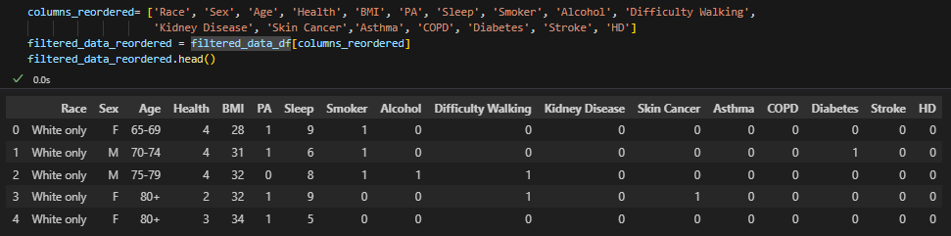

Data Cleaning (continue)
Combine rows as required
Convert data to numerical value for more efficient analysis
Reordering the dataset {Demographic, Lifestyle and Behaviour, Health Indicator}
Final clean dataset:

Slide 5


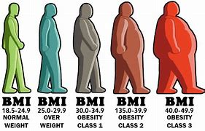
Initial Analysis
Objective: Investigate relationship between each parameter and HD
There are 2 types of dataset:
Categoric (14) – Sex, Diabetes, Race, etc
Numerical (2) – BMI, Sleep
Categoric
Visualisation: Bar Plot
Test: Chi2, p=0 for all
Numerical
Visualisation: Box and Violin Plot
Test: Shapiro – Wilk, p=0 for all

Slide 6
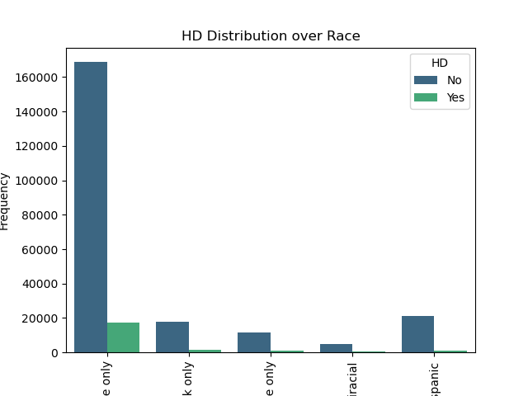
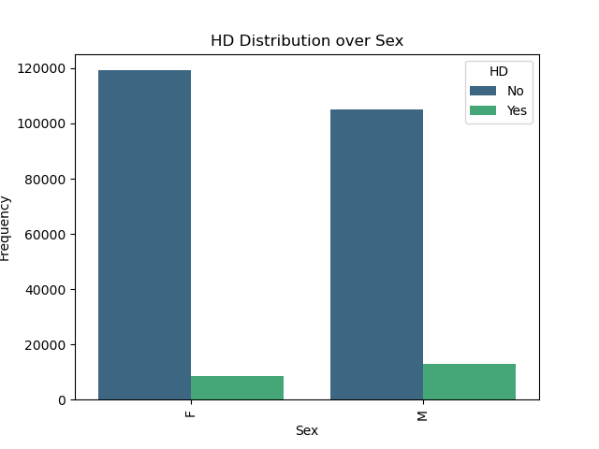
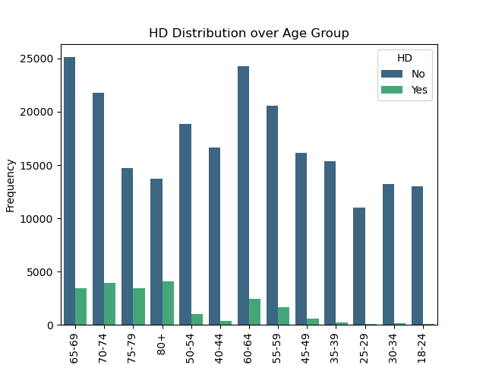
Initial Analysis (Demographic)

Slide 7
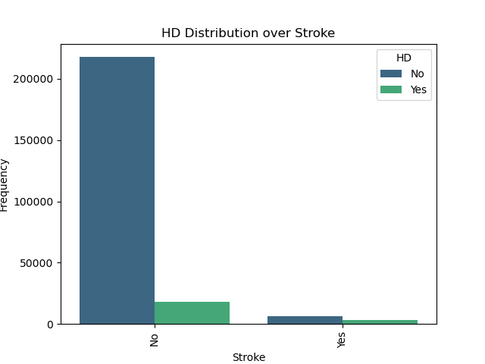
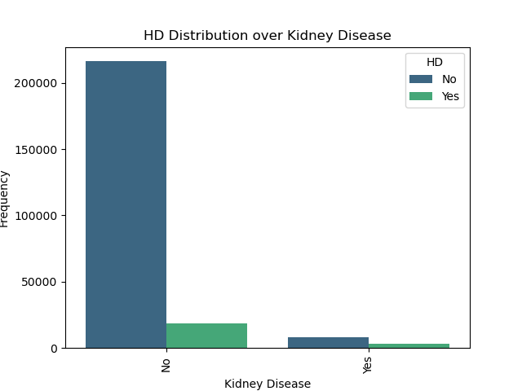
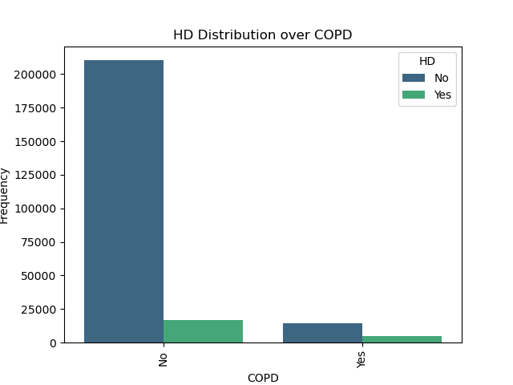
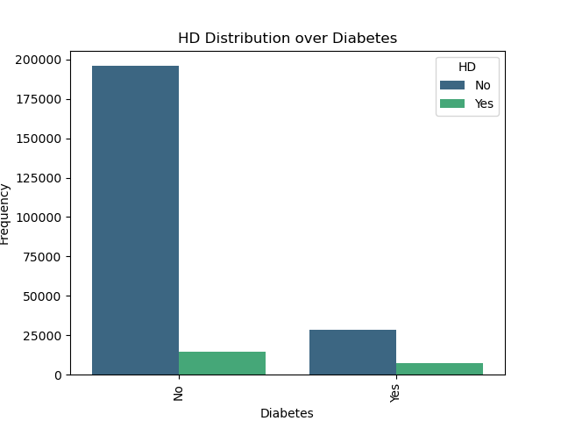
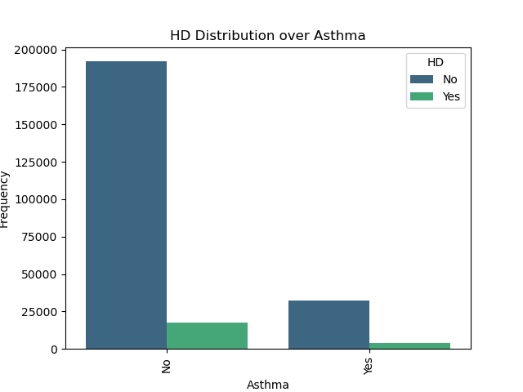

Initial Analysis (Health Indicator)

Slide 8
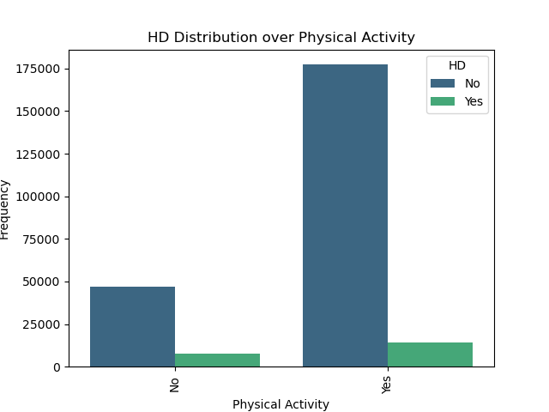
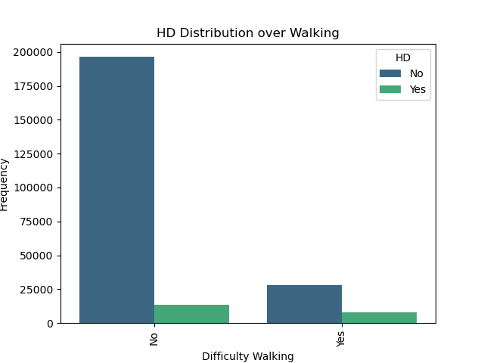
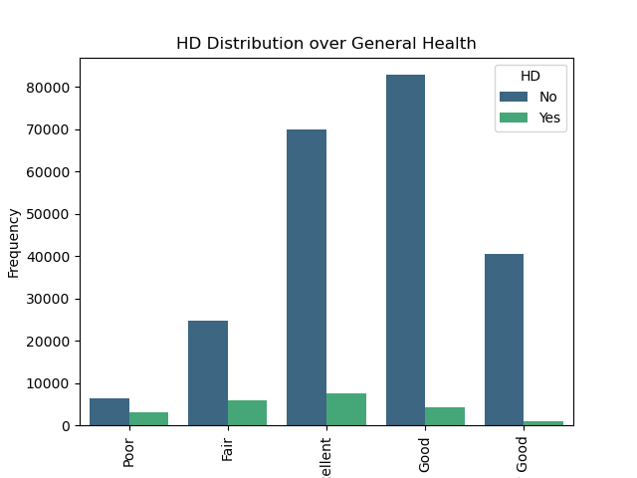
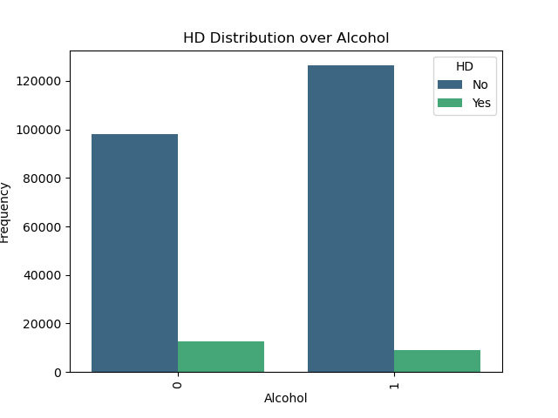
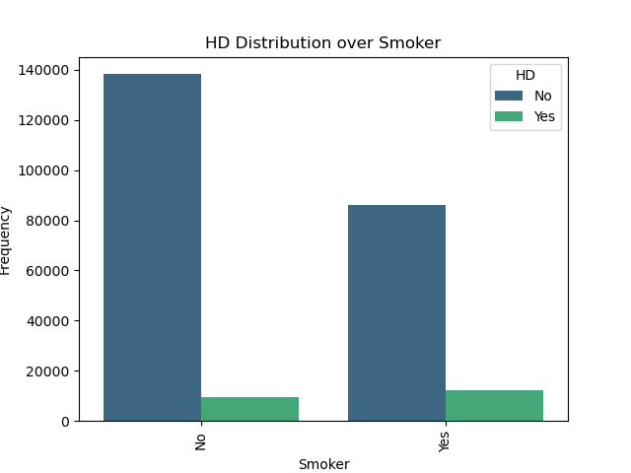
Initial Analysis (Lifestyle and Behaviour)

Slide 9
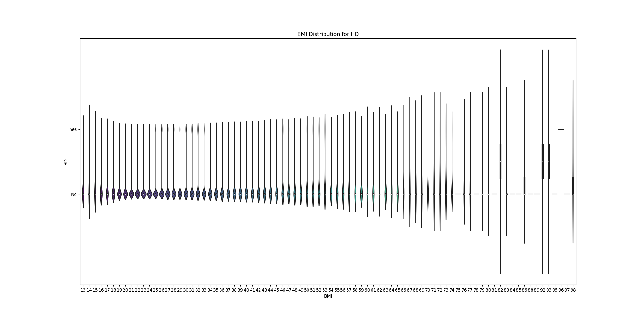
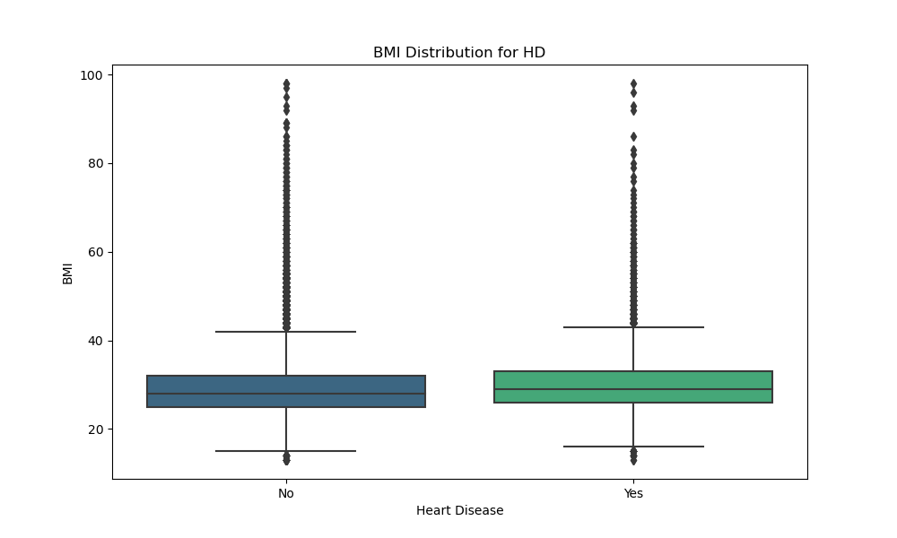
Initial Analysis (Lifestyle and Behaviour) (continue)

Slide 10
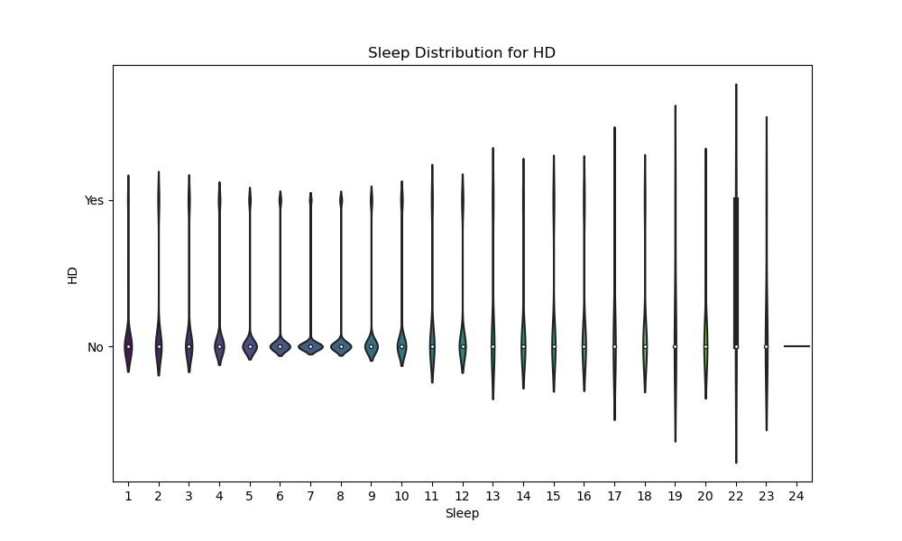
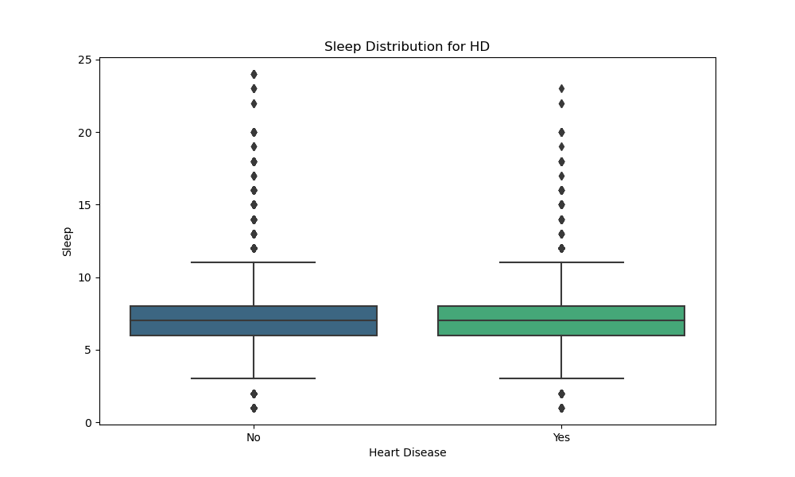
Initial Analysis (Lifestyle and Behaviour) (continue)

Slide 11
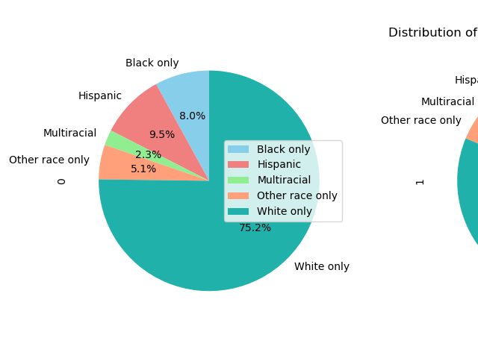
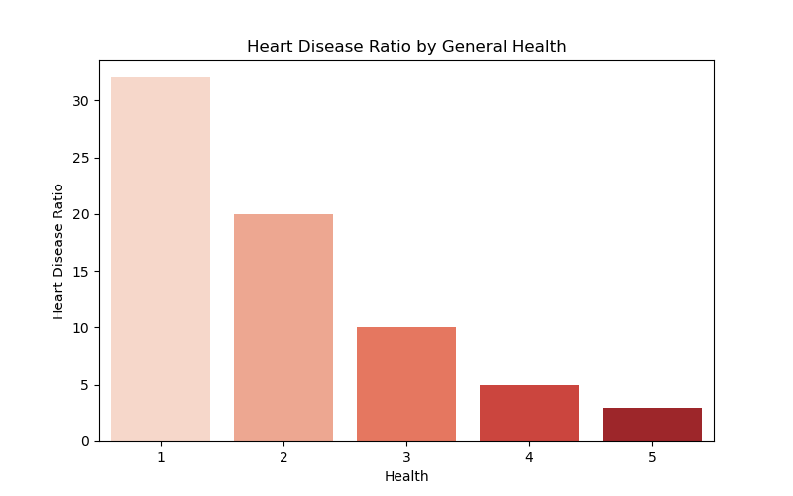
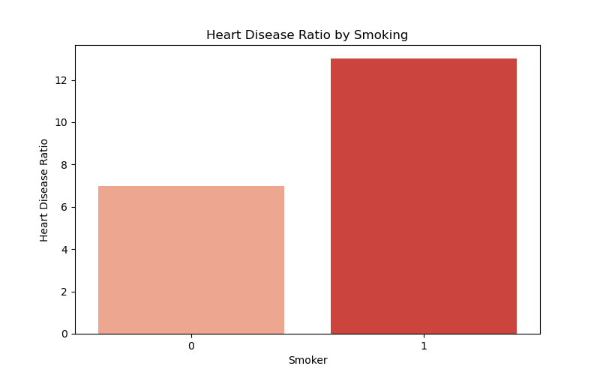
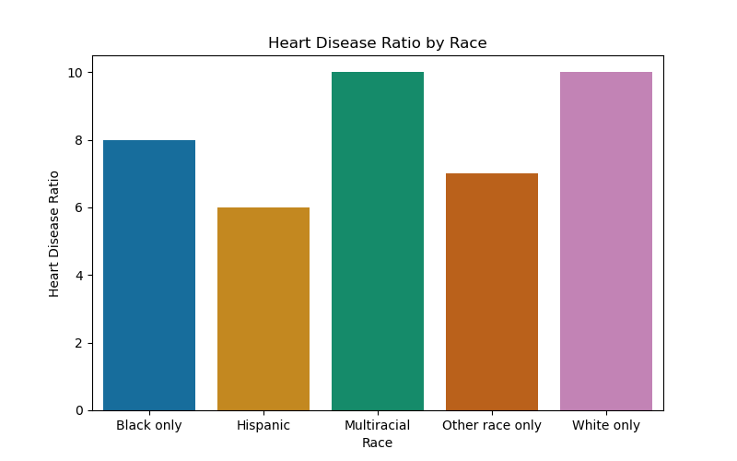
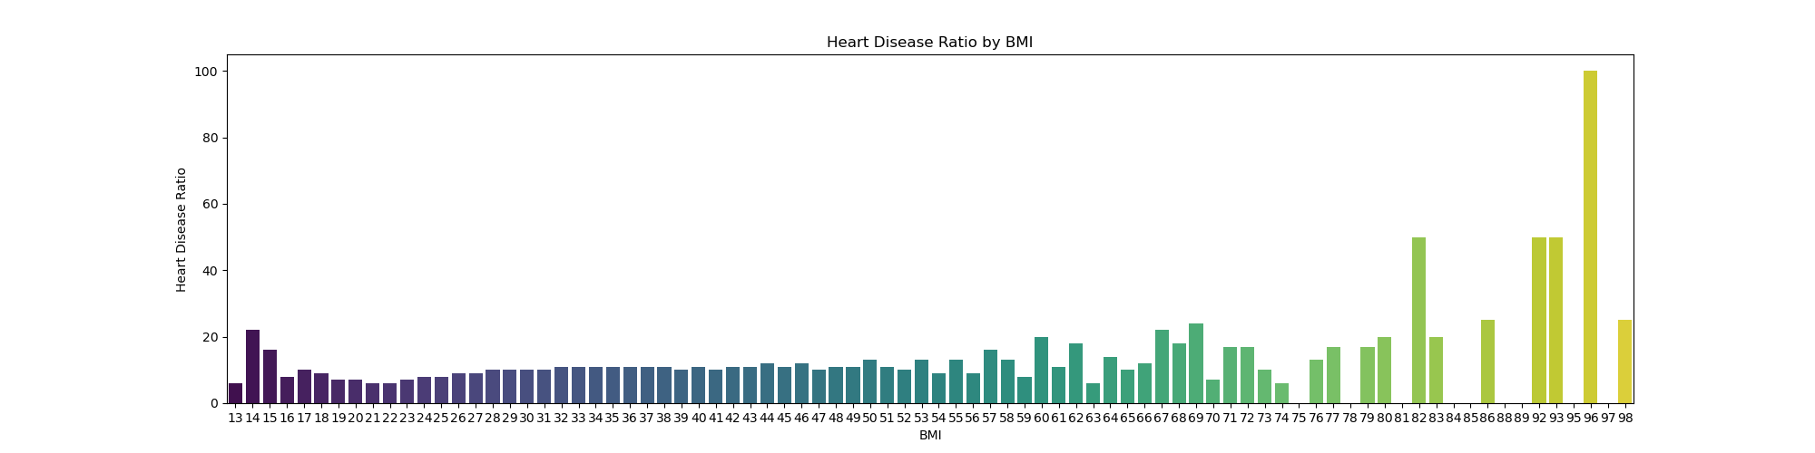
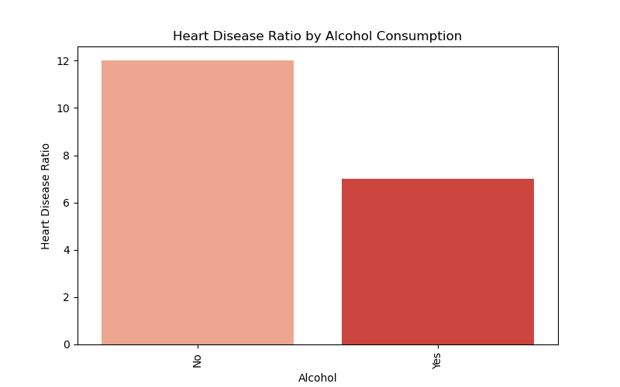
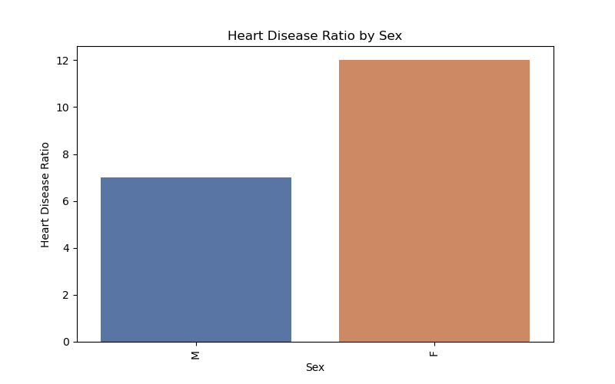
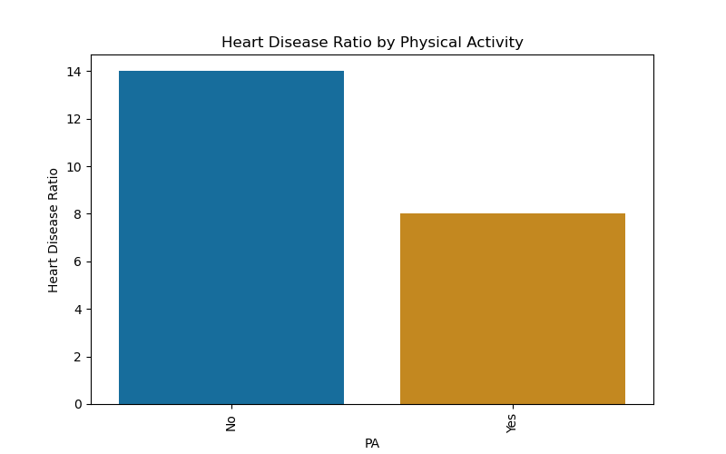
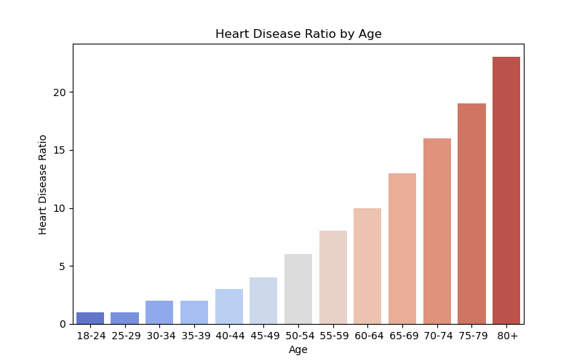
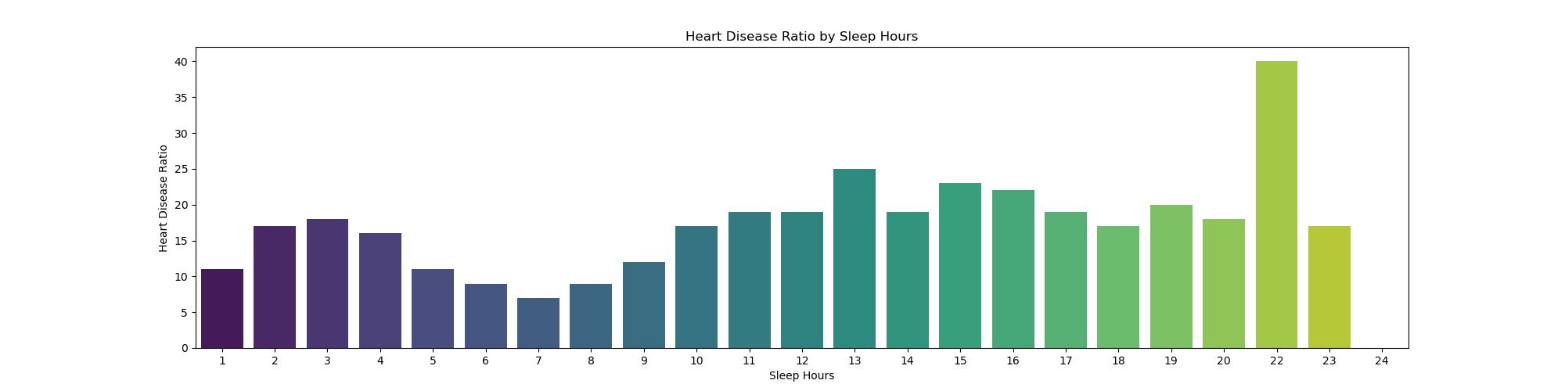
Deep Dive into the Data
Demographic Indicators
Lifestyle Indicators

Slide 12
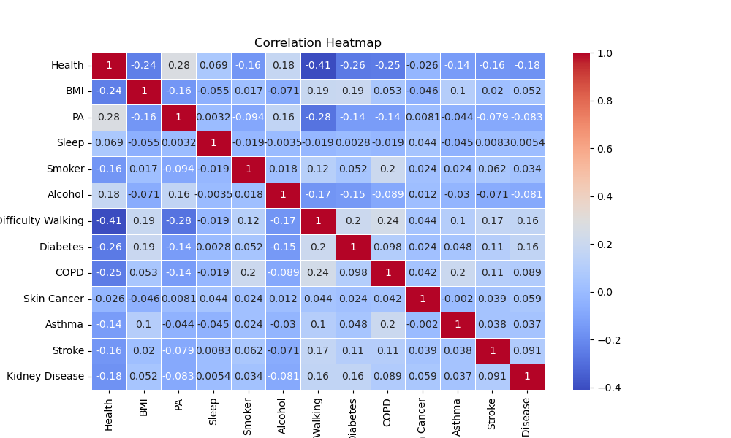
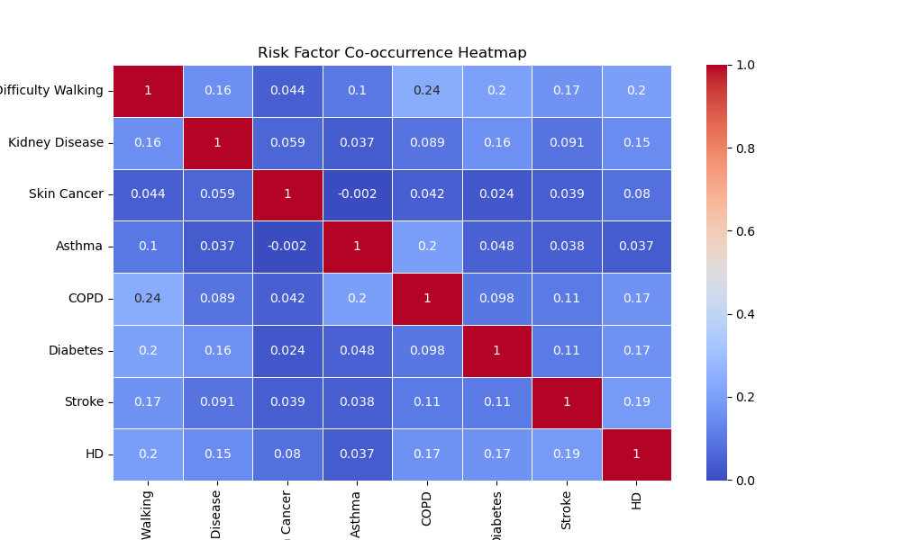
Deep Dive into the Data

Slide 13
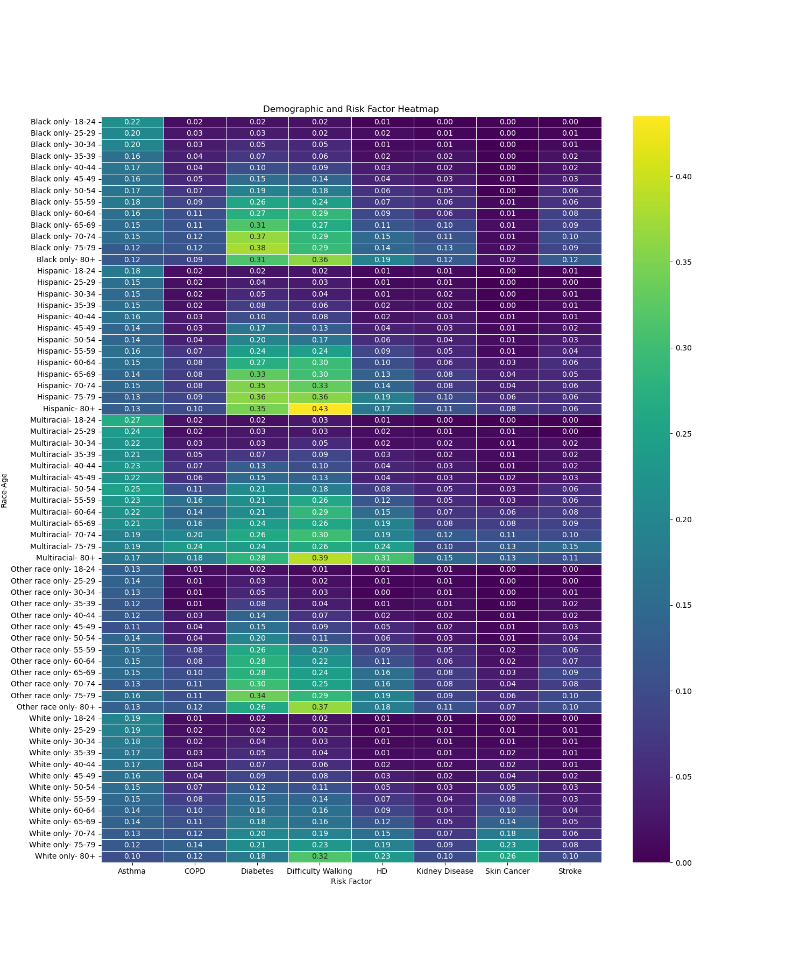
Deep Dive into the Data

Slide 14
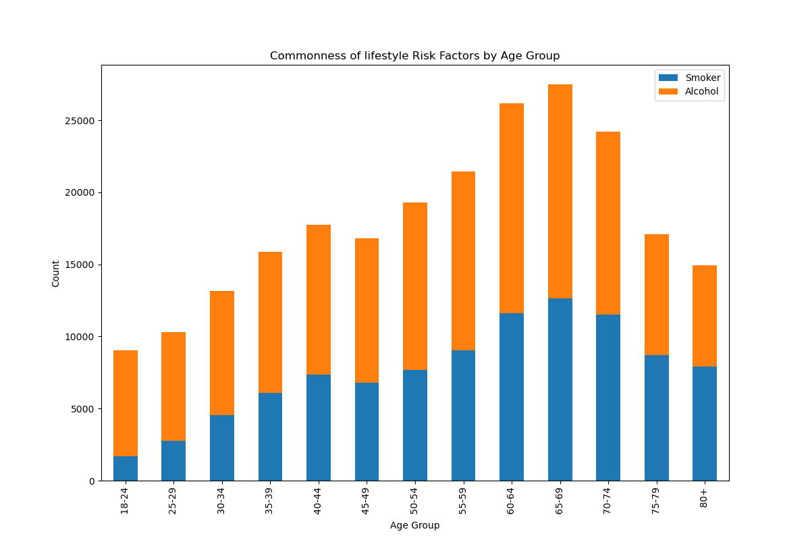
Deep Dive into the Data

Slide 15
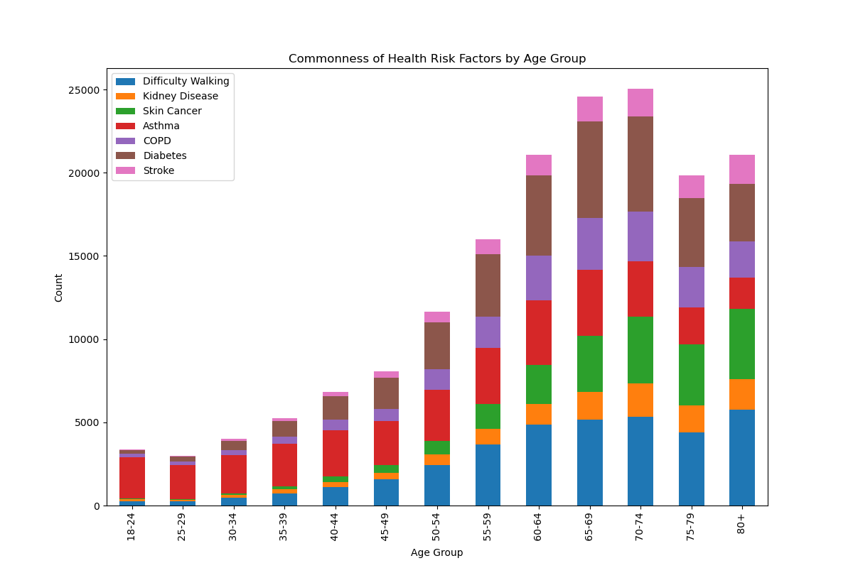
Deep Dive into the Data

Slide 16
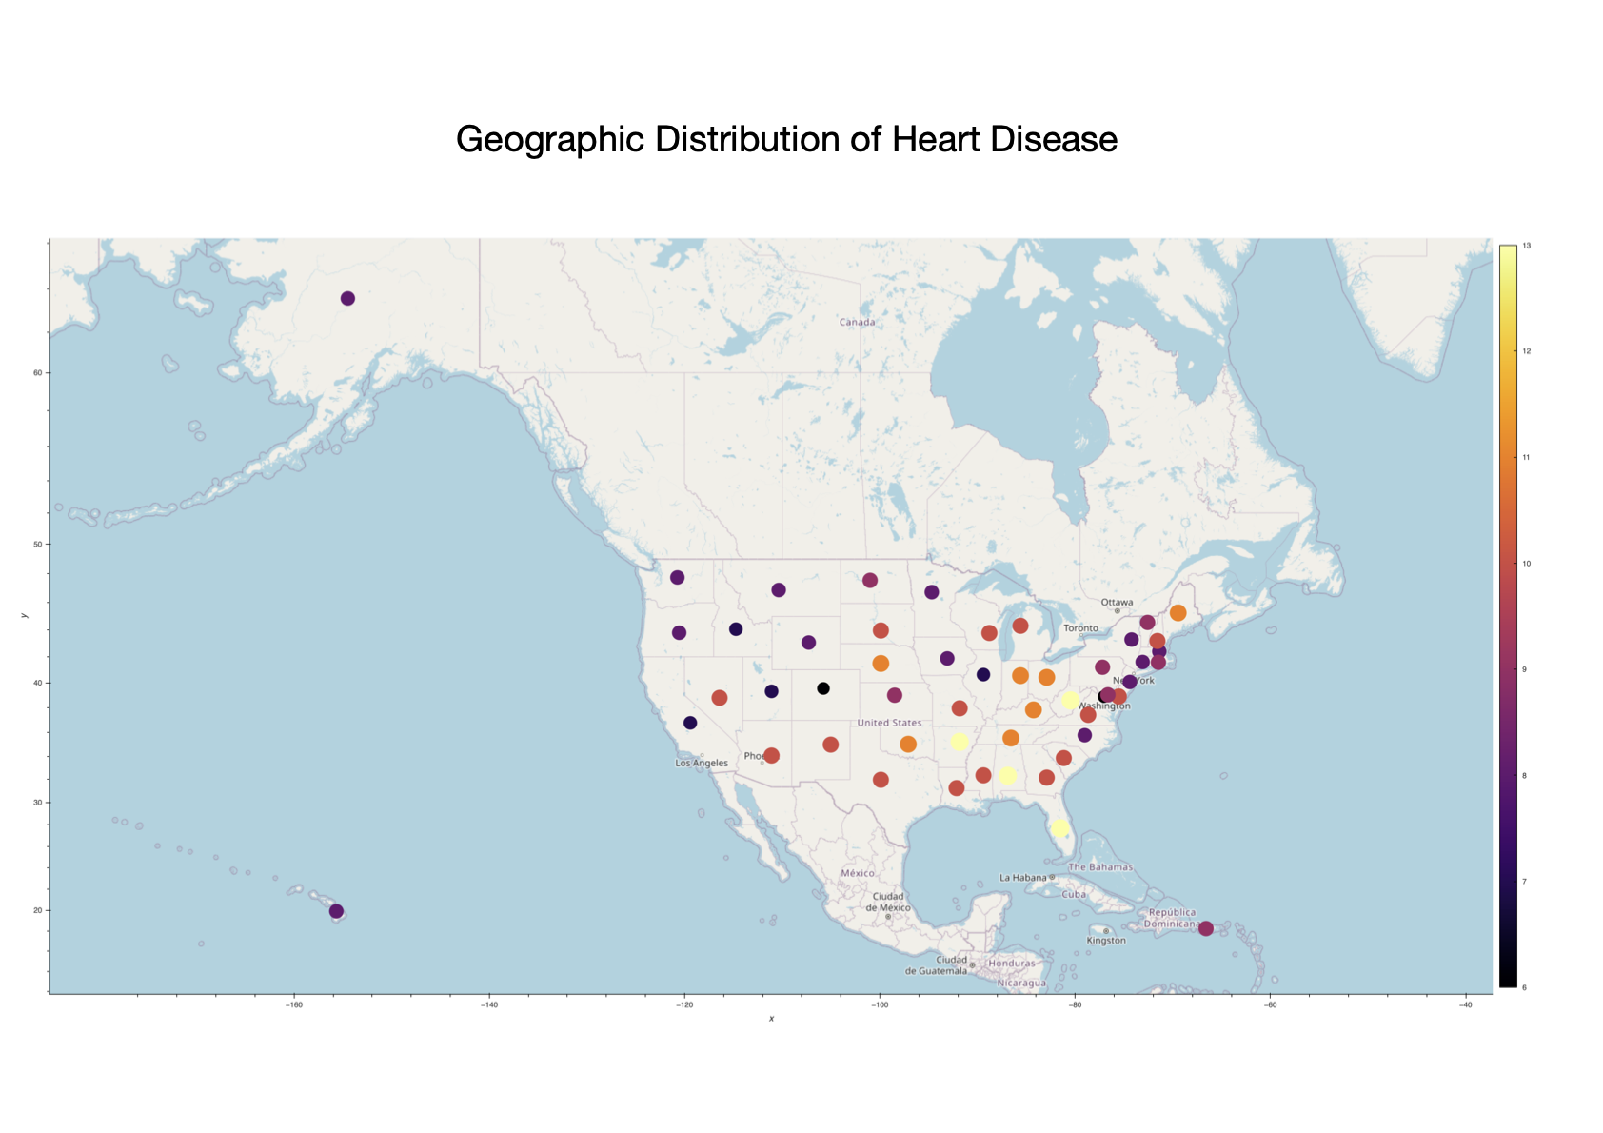
Geographic Distribution of HD

Slide 17
States with the lowest HD Ratio
State | HD Ratio
Idaho | 7.0
California | 7.0
Utah | 7.0
Colorado | 6.0

Slide 18
States with the highest HD Ratio
State
Alabama | 13.0
Arkansas | 13.0
Florida | 13.0
West Virginia | 13.0

Slide 19
Geographic Distribution of HD

Slide 20
Summary and Conclusion
The primary objective of the project was to identify which variables have a significant effect on the likelihood of heart disease and to contribute to a deeper understanding of health-related factors and their impact on heart disease outcomes.
A selected number of indicators of interest were grouped together and tested as demographical, lifestyle/behavioral, and medical condition parameters. Preliminary statistical analyses ascertained a statistically significant association between each parameter suggesting their dependence. The data visualizations conducted, offered deeper insights, confirming direct and in some cases linear influence of age, general health, BMI, physical activity, hours of sleep, ability to walk and smoking on potentially increasing the chance of having heart diseases. While alcohol consumption provided contradictory results to that of public perception, it could be clearly deduced from analyzing other medical condition indicators that overall having any pre-existing condition could contribute to heart diseases with various strength of correlations. While race did not provide any strong correlations for heart diseases particularly, but it showed interdependency with some of the risk factors.
With a final geographical analysis of our data, it was apparent that some states have higher ratio of people with heart diseases from the overall number of people tested. People in same states potentially share commonalities such as history, economic status, culture, healthcare access, and lifestyle. Overcoming the main limiting factor of test subjects all from U.S., this project could lay some ground for further studies in the relationship between different risk factors and geography with heart disease to raise awareness and improve general health of public.

